Slide 1
PRONOUNS
Pronouns
Pronouns

Slide 2
Personal or Subject Pronouns ➭ before the verb
I
You
He
She
It
We
You
They
am vegan
never eat meat
walks to work
always reads science fiction
is cold
are late
all go together
have a problem

Slide 3
Object Pronouns ➭used after a verb or a preposition
me
you
him
her
it
us
you
them
Listen to me
I am talking to you
Look at him
You don’t love her
They can’t understand it
Come with us
The teacher is angry with all of you
I never tell them anything

Slide 4
Possessive Adjectives ➭always used with a noun
my
your
his
her
its
our
your
their
My cats are my best friends
Your dog is awesome
He is Juan and Alba is his daughter
She is Luisa and Juan is her son
Everything in this city is amazing. Its people, its climate, its food, its beaches…
This is our classroom
You all have to do your homework
They should learn from their parents how to behave

Slide 5
Possessive Pronouns➭replace the noun
mine
yours
his
hers
ours
yours
theirs
This vegan burger is mine
Is this kitten yours? She is so pretty
Is that bike his?
No, it is hers
Those books were ours
I can’t see my dog but yours is here
The poems they recited were theirs

Slide 6
Reflexive Pronouns ➭subject and object are the same
myself
yourself
himself
herself
itself
ourselves
yourselves
themselves
I try to understand myself
Do you make yourself laugh?
He is talking to himself
She tells herself that she doesn’t need anyone
Mankind contravenes itself and its future
We will look at ourselves in the mirror
You both asked yourselves a lot of things
Humans endanger themselves and other species with their actions

Slide 7
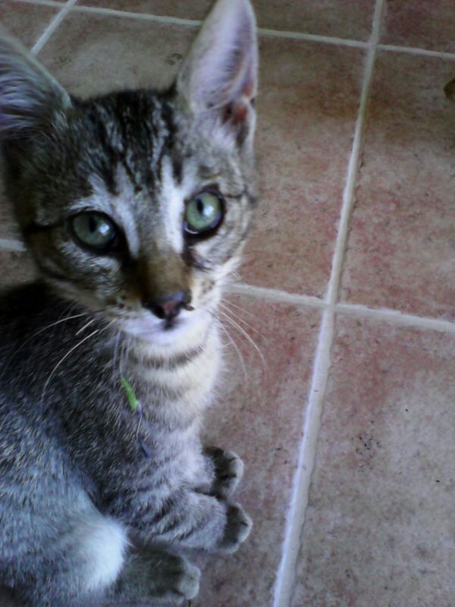
➣I love my cat
➣You love your cat
➣He loves his cat
➣She loves her cat
➣We love our cat
➣You both love your cat
➣They love their cat

Slide 8
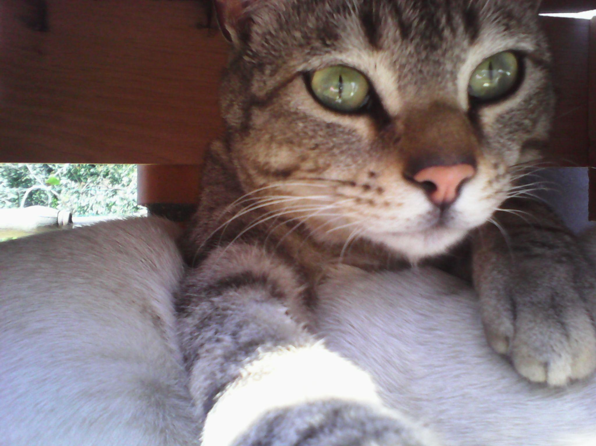
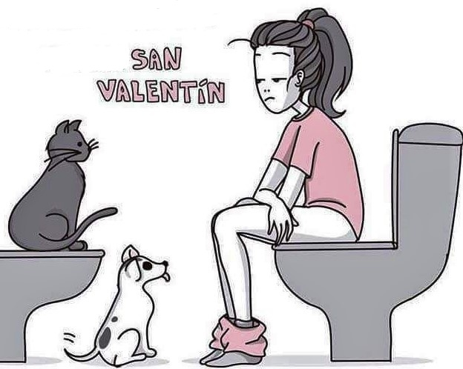
➣He tolerates me
➣He tolerates you
➣He tolerates him
➣He tolerates her
➣He tolerates us
➣He tolerates you all
➣He tolerates them

Slide 9
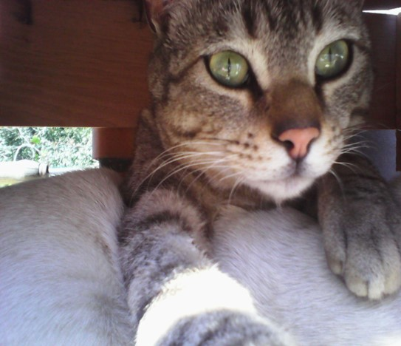
➣I tell myself that he is mine
➣You tell yourself that he is yours
➣He tells himself that he is his
➣She tells herself that he is hers
➣We tell ourselves that he is ours
➣You tell yourselves that he is yours
➣They tell themselves that he is theirs

Slide 10
Let’s practice - Replace all nouns with pronouns
Will your son help Lucy?
I'll ask Peter
Where are my glasses?
I love peaches
When is the faculty meeting?
Did you meet the boys?
Your friend is sending an email
Will he help her?
I'll ask him
Where are they?
I love them
When is it?
Did you meet them?
He is sending it

